Slide 1


Open Source Diversity
CONTRIBUTION DAY

Slide 2


Slide 3

WIFI: twguest
dingy tiger slacks
accustom pretzel

Slide 4
Inclusion & Diversity
in Open Source Projects
opensourcediversity.org
@osdiversity #opensourcediversity

Slide 5
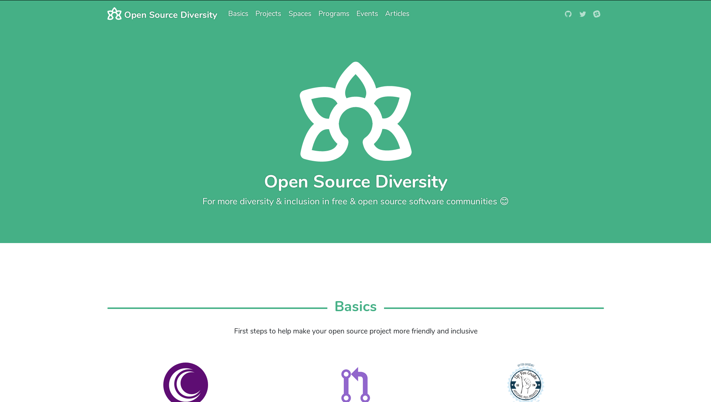

Slide 6
No regular meetups, only special events
http://opencollective.com/opensourcediversity

Slide 7

meetup.com/turkishtech
turkishtech.org
About
Collaborative for technology professionals of turkish origin and internationals
Collaboration and exchange of the underrepresented in tech to add value and diversity to Berlin's technology ecosystem
Mission
Embrace and own underrepresented and marginalized communities
Raise awareness for inclusion
Help build foundation for a more diverse tech community

Slide 8

www.womenwhocode.com
bit.ly/WWCBerlinFacebookGroup
@WWCodeBerlin
berlin@womenwhocode.com

Slide 9
Our Events
Talk Nights (monthly)
Workshops
Hack Evenings (biweekly)
next one is on Oct 29 @Hello Fresh
https://www.meetup.com/de-DE/Women-Who-Code-Berlin-Germany/

Slide 10


@PyLadiesBer
Notes:
Hi everyone, are you enjoying the conference?
I am absolutely buzzing, this is my first large tech conference since I left my job last year to learn programming and it is pretty darn amazing. Such a fantastic line up of speakers, both on the main stages and here in the community lounge and its been so inspiring and encouraging speaking with many of you here.
The community here in Berlin is exceptional but it is really motivating to see how far that reaches.

Slide 11

Upcoming Meetups
November 9th Python Pizza Hamburg 🍕
November 10th Coffee, Cake & Code Hamburg 🍰☕
November 19th Devops Docker edition 🐳
December 10th End of Year Special 🎉
https://www.meetup.com/PyLadies-Berlin/

Slide 12

Every contribution counts!

Slide 13

How it works:
Sign up for Hacktoberfest
Make 4 Pull Requests
Get a T-Shirt!

Slide 14
Rules
Pull Requests have to be on GitHub
On a public repo
Between October 1st and 31th
Pull requests can not be marked as Spam by maintainers - follow the Contribution Guidelines!

Slide 15


THE SEARCH ENGINE THAT PLANTS TREES

Slide 16


Thoughtworks

Slide 17
Code of Conduct
Contributor Covenant
https://github.com/opensourcediversity/opensourcediversity.org/blob/master/code-of-conduct.md

Slide 18
How to get involved
in open source projects
opensourcediversity.org
@osdiversity #opensourcediversity

Slide 19
Development
Design
Documentation
Event organization
Marketing
Testing
Translation
…
Notes:
… and that leaves out plenty of people

Slide 20



Slide 21
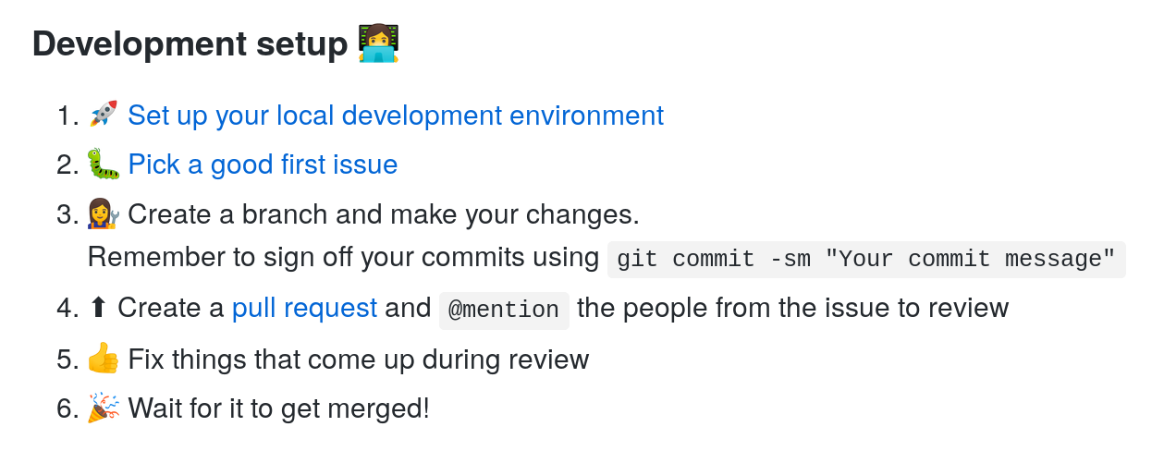

Slide 22


Slide 23
Bring your
QUESTIONS
Post them on the Q&A wall
& follow @osdiversity on Twitter

Slide 24
Celebrate your CONTRIBUTIONS
Come to the Stage & get your pick

Slide 25
Thank you
& have fun!
opensourcediversity.org
@osdiversity #opensourcediversity

Slide 26
WIFI: twguest
dingy tiger slacks
accustom pretzel

Slide 27
Forum:
discourse
.opensourcediversity
.org/c/projects

